Slide 1
雲端計算
Cloud Computing
PaaS Techniques
Programming Model

Slide 2
Agenda
Overview
  Hadoop & Google
PaaS Techniques
  File System
    GFS, HDFS
  Programming Model
    MapReduce, Pregel
  Storage System for Structured Data
    Bigtable, Hbase

Slide 3
MapReduce
How to process large data sets and easily
utilize the resources of a large distributed system …

Slide 4
MapReduce
Introduction
Programming Model
Implementation
Refinement
Hadoop MapReduce

Slide 5

How much data?
Google processes 20 PB a day (2008)
Wayback Machine has 3 PB + 100 TB/month (3/2009)
Facebook has 2.5 PB of user data + 15 TB/day (4/2009)
eBay has 6.5 PB of user data + 50 TB/day (5/2009)
CERN’s LHC will generate 15 PB per year
How about the future…
640K ought to be enough for anybody.

Slide 6
Divide and Conquer
“Work”
Partition
w₁
w₂
w₃
“worker”
“worker”
“worker”
r₁
r₂
r₃
Combine
“Result”

Slide 7
How About Parallelization
Difficult because
  We don’t know the order in which workers run
  We don’t know when workers interrupt each other
  We don’t know the order in which workers access shared data
Thus, we need:
  Semaphores (lock, unlock)
  Conditional variables (wait, notify, broadcast)
  Barriers
Still, lots of problems:
  Deadlock, livelock, race conditions...
  Dining philosophers, sleeping barbers, cigarette smokers...

Slide 8
Current Tools
Programming models
  Shared memory (pthreads)
  Message passing (MPI)
Design Patterns
  Master-slaves
  Producer-consumer flows
  Shared work queues
Shared Memory
Message Passing
Memory
P₁
P₂
P₃
P₄
P₅
P₁
P₂
P₃
P₄
P₅
producer
consumer
master
work queue
slaves
producer
consumer

Slide 9
Do Problems really Solve?
Concurrency is difficult to reason about
Concurrency is even more difficult to reason about
  At the scale of datacenters (even across datacenters)
  In the presence of failures
  In terms of multiple interacting services
Not to mention debugging…
The reality:
  Lots of one-off solutions, custom code
  Write you own dedicated library, then program with it
  Burden on the programmer to explicitly manage everything

Slide 10
What is MapReduce
Programming model for expressing distributed computations at a massive scale
A patented software framework introduced by Google
  Processes 20 petabytes of data per day
Popularized by open-source Hadoop project
  Used at Yahoo!, Facebook, Amazon, …
Cloud Applications
MapReduce
Hbase
Hadoop Distributed
File System (HDFS)
A Cluster of Machines

Slide 11
Why MapReduce
Scale “out”, not “up”
  Limits of Symmetrical Multi-Processing (SMP) and large shared-memory machines
Move computing to data
  Cluster have limited bandwidth
Hide system-level details from the developers
  No more race conditions, lock contention, etc
Separating the what from how
  Developer specifies the computation that needs to be performed
  Execution framework (“runtime”) handles actual execution

Slide 12
MapReduce
Introduction
Programming Model
Implementation
Refinement
Hadoop MapReduce

Slide 13
Typical Large-Data Problem
Iterate over a large number of records
Extract something of interest from each
Shuffle and sort intermediate results
Aggregate intermediate results
Generate final output
Map
Reduce
Key idea: provide a functional abstraction for these two operations

Slide 14
How to Abstract
The framework is inspired by map and reduce functions commonly used in functional programming, although their purpose in the MapReduce framework is not the same as their original forms
  Map(...) : N → N
    Ex. [ 1,2,3,4 ] – (*2) -> [ 2,4,6,8 ]
  Reduce(...): N → 1
    [ 1,2,3,4 ] – (sum) -> 10
Programmers specify two functions:
  Map(k1,v1) -> list(k2,v2)
  Reduce(k2, list (v2)) -> list(v3)
  All values with the same key are sent to the same reducer

Slide 15
How to Abstract(Cont.)
The execution framework (Runtime) handles
  Scheduling
    Assigns workers to map and reduce tasks
  Data distribution
    Moves processes to data
  Synchronization
    Gathers, sorts, and shuffles intermediate data
  Errors and faults
    Detects worker failures and restarts
  Everything happens on top of a Distributed File System (DFS)

Slide 16
MapReduce
Introduction
Programming Model
Implementation
Refinement
Hadoop MapReduce

Slide 17
Environment (Google)
A cluster with
  Hundreds/Thousands of dual-processor x86 machines
  2-4 GB of memory per machine
  Running Linux
  Storage is on local inexpensive IDE disks
  100 Mbits/sec or 1 Gbits/sec limited bisection bandwidth
Software level
  Distributed file system: Google File System
  Job scheduling system
    Each job consists of a set of tasks
    Scheduler assigns tasks to machines

Slide 18
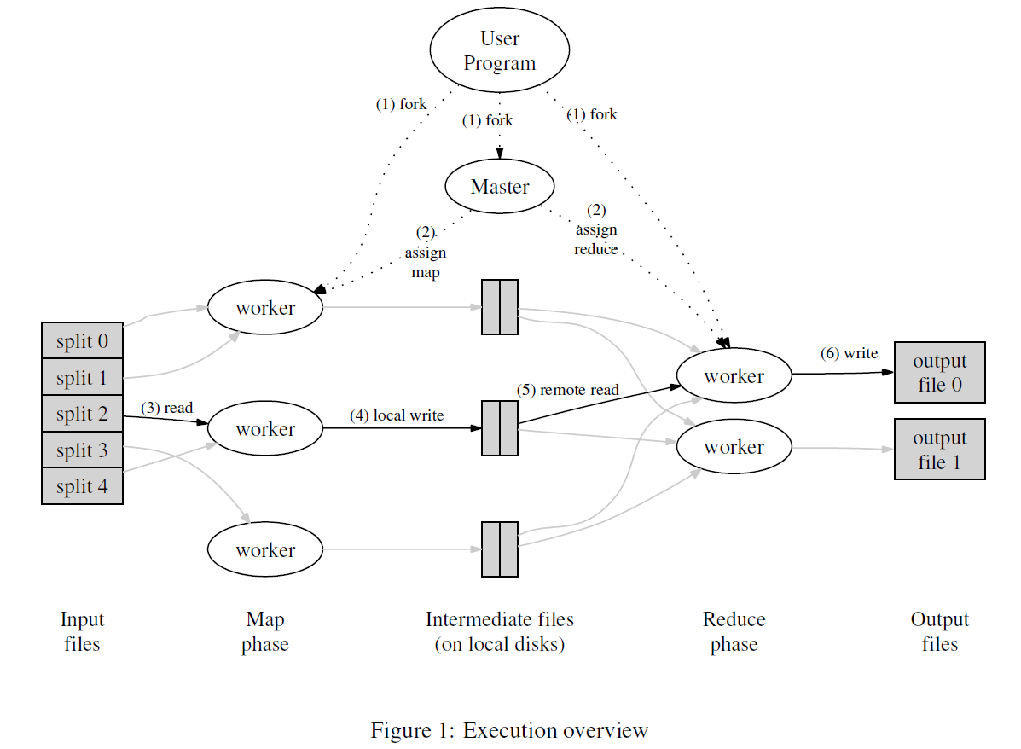
Execution Overview

Slide 19
Fault Tolerance
Worker failure
  To detect failure, the master pings every worker periodically
  Re-execute completed and in-progress map tasks
  Re-execute in progress reduce tasks
  Task completion committed through master
Master failure
  Current implementation aborts the MapReduce computation if the master fails

Slide 20
Locality
Don’t move data to workers… move workers to the data!
  Store data on the local disks of nodes in the cluster
  Start up the workers on the node that has the data
Why?
  Not enough RAM to hold all the data in memory
  Disk access is slow, but disk throughput is reasonable
A distributed file system is the answer
  GFS (Google File System) for Google’s MapReduce
  HDFS (Hadoop Distributed File System) for Hadoop

Slide 21
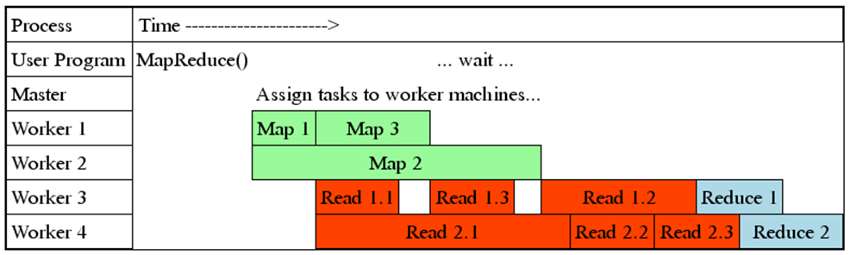
Task Granularity
Many more map and reduce tasks than machines
  Minimizes time for fault recovery
  Can pipeline shuffling with map execution
  Better dynamic load balancing
Often use 200,000 map and 5000 reduce tasks with 2000 machines

Slide 22
MapReduce
Introduction
Programming Model
Implementation
Refinement
Hadoop MapReduce

Slide 23
Input/Output Types
Several different input formats
  “Text” format
    Key: offset in the file
    Value: content of the file
  Another common format
    Sequence of key/value pairs sorted by key
  Split itself (every format) into meaningful ranges
  Need new type?
    Provide an implementation of a simple reader interface
Output types design is similar to input.

Slide 24
Partitioner and Combiner
The same keys to the same reducer via network
  Partitioner function
    A default partitioning function is provided that uses hashing
    In some cases, it is useful to partition data by some other function of the key
Avoid communication via local aggregation
  Combiner function
    Synchronization requires communication, and communication kills performance
    Partial combining significantly speeds up certain classes of MapReduce operations

Slide 25
MapReduce
Introduction
Programming Model
Implementation
Refinement
Hadoop MapReduce

Slide 26
JobTracker & Tasktracker
JobTracker
  Master Node－Master
  Scheduling the jobs' component tasks on the slaves
  Monitoring slaves and re-executing the failed tasks
TaskTrakers
  Slave Nodes－Workers
  Execute the tasks (Map/Reduce) as directed by the master
  Save results and report task status

Slide 27
Hadoop MapReduce w/ HDFS
master node
namenode
job submission node
namenode daemon
jobtracker
Map
Red
Map
tasktracker
tasktracker
tasktracker
Split 0
datanode daemon
datanode daemon
datanode daemon
Linux file system
Linux file system
Linux file system
…
…
…
slave node
slave node
slave node
Split 1

Slide 28
Hadoop MapReduce work flow
Input
Mapper
Sort/Copy
Output
Merge
Split 0
Reducer
Part0
Split 1
Mapper
Split 2
Reducer
Part1
Mapper
Split 3
<key, value>

Slide 29
Example
Input
Mapper
Sort/Copy
Hello 1
Output
Cloud 1
Merge
Hello Cloud
Reducer
Hello 1
Hello [1 1]
YC [1 1]
Hello 2
YC 2
Hello 1
YC 1
Mapper
YC 1
YC cool
YC 1
cool 1
cool 1
Hello YC
Reducer
Cloud 1
cool 2
Cloud 1
Cloud [1]
cool [1 1]
cool 1
cool 1
Mapper
cool
Hello 1
YC 1

Slide 30
Summary of MapReduce
MapReduce has proven to be a useful abstraction
  Hides the details of parallelization, fault-tolerance, locality optimization, and load balancing.
  A large variety of problems are easily expressible as MapReduce computations.
  Even for programmers without experience with parallel and distributed systems
Greatly simplifies large-scale computations at Google

Slide 31
Pregel
A system for large-scale graph processing

Slide 32
Introduction
The Internet made the Web graph a poplar object of analysis and research.
In Google, MapReduce is used for 80% of all the data processing needs.
The other 20% is handled by a lesser known infrastructure called Pregel which is optimized to mine relationships from graphs.

Slide 33
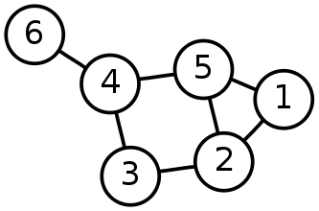
Introduction(cont.)
Graph is a collection of vertices or nodes and a collection of edges that connect pair of nodes.
A graph is a collection of points and lines connecting some (possibly empty) subset of them.
- wikipedia
- mathworld

Slide 34

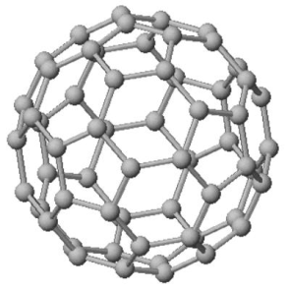
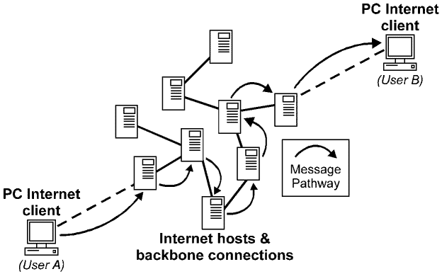
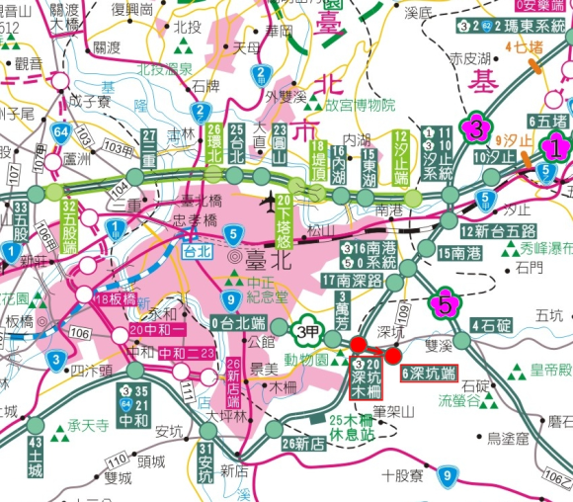
Introduction(cont.)
Graph does not just mean the image, most of the time in Internet, graph means the relations between nodes.

Slide 35
model
Model
Implement
Communication

Slide 36
Model
The high-level organization of Pregel programs is inspired by Valiant’s Bulk Synchronous Parallel (BSP) model.
The synchronicity of this model makes it easier to reason about program semantics when implementing algorithms.
Pregel programs are inherently free of deadlocks and data races common in asynchronous systems.

Slide 37
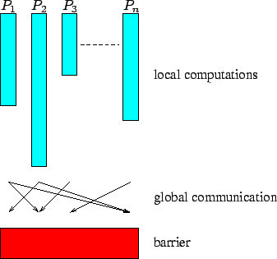
BSP Model
A BSP computation proceeds in a series of global supersteps.
  Local computation
  Global communication
  Barrier synchronization
1. Run algorithm on each machine
2. Communicate with each other
3. Wait

Slide 38
Pregel Model
The Pregel library divides a graph into partitions, each consisting of a set of vertices and all of those vertices’ outgoing edges.
There are three component in Pregel
  Master
  Worker
  Aggregator
Master
Aggregator
Worker
Worker
Worker
Worker

Slide 39
Pregel Model
Master
  Assign jobs to workers.
  Receive result from workers.
Worker
  Execute jobs from master.
  Deliver result to master.
Aggregator
  A global container that can receive message from workers.
  Automatic computation all the message according by user defined.

Slide 40
Partition
In Pregel model, each graph is directly which each vertex has a unique id and each edge has a value user defined.
Graph can be divided into partitions
  A set of vertices
  All of these vertices’ outgoing edges
Partition

Slide 41
Partition(cont.)
Pregel provides a default assignment where partition function is hash(nodeID) mod N, where N is the number of partitions, but user can overwrite this assignment algorithm.
In general, it is a good idea to put close-neighbor nodes into the same partition so that message between these nodes can reduce overhead.

Slide 42
Worker Model
There are two status types for each vertex
  Active
  Inactive
The algorithm as a whole terminates when all vertices are simultaneously inactive and there are no messages in transit.
Every vertex is in the active state in superstep 0.
Vote to halt
Active
Inactive
Message received

Slide 43
Worker Model
Initial
Worker
Receive message
Computation
Communication
Inactive
Barrier

Slide 44
model
Model
Implement
Communication

Slide 45
Master
The master is primarily responsible for coordinating the activities of workers.
Master sends the same request to every worker that was known to be alive at begin, and waits for a response from every works.
If any worker fails, the master enters recovery mode.

Slide 46
Master
Alive ?
I’m waiting
Master
Job
Job
Job
Result 0
Result 1
Result 2
worker
worker
worker
Yes
Yes
Yes

Slide 47
Worker
A worker machine maintains the state of its portion of the graph in memory.
Worker performs a superstep it loop through all vertices and calls Compute().
Worker is no access to incoming edges because each incoming edge is part of a list owned by the source vertex.

Slide 48
Worker
An incoming iterator to the
incoming message.
Run algorithm by calling
Compute()
An outgoing iterator to
send message
Incoming
Iterator
Outgoing
Iterator
Call Compute()

Slide 49
Aggregators
An aggregator computes a single global value by applying an aggregation function to a set of values that the user supplies.
Worker combines all of the values supplied to an aggregator instance when executes a superstep.
An aggregator is partially reduced over all of the worker’s vertices in the partition.
At the end of superstep workers form a tree to reduce partially reduced aggregator into global values and deliver them to the master.

Slide 50
Failure Recover
Worker failure are detected using regular ‘ping’ messages that master issues to workers.
If a worker does not receive a ping message after a special interval, the worker process terminates.
If the master does not hear back from a worker, the master marks the worker process as failed.

Slide 51
Failure Recover (cont.)
If one or more workers fail, the master reassigns graph partitions, these workers performed, to the currently available set of workers.
Workers reload their partition state from the most resent available checkpoint at the begin superstep.

Slide 52
model
Model
Implement
Communication

Slide 53
Communication
Vertices communicate directly with one another by sending message.
In pregel, there are many virtual functions that can be overridden by programmer.
  Compute
  Combiners
  Aggregators
Algorithm
Communication for some purpose

Slide 54
Communication
A vertex can send any number of messages in a superstep.
All message sent to vertex V in superstep S are available, via an iterator, but not guaranteed order of messages in the iterator.
Vertex V sent message to destination vertex, which need not be a neighbor of V.

Slide 55
Communication(cont.)
A vertex cloud learn the identifier of a non-neighbor from a message received earlier, or could be know implicitly.
When destination vertex does not exist, pregel execute user-defined handles, like create the missing vertex or remove the dangling edge.
message
message
Execute exception handle
1. Add vertex
2. Remove edge
?

Slide 56
Combiners
Combiners can combine several messages into a single message.
Combiners are not enabled by a default, because there is no mechanical way to find a useful combining function that is consistent.
Combiners does not guarantee about which messages are combined, the groupings presented to the combiner, or the order of combining.
  Combiner should only be enable for commutative and associative operator.

Slide 57
Aggregators
Pregel aggregators are a mechanism for global communication, monitoring, and data.
Each vertex can provide a value to an aggregator in superstep S, the system combines thosevalues using a reduction operator, and the resulting value is make available to all vertices in superstep S+1.
  Minimum
  Summary
  …etc

Slide 58
Communication(cont.)
Sending a message, especially to a vertex on another machine, incurs some overhead.
…
Aggregator
Result
Combiner
…
superstep:=
S
S+1

Slide 59
Sample case
Shortest Paths –
The shortest path problem is the best well-know problem in graph theory

Slide 60
Shortest Paths
Phrase 0
  Assume the value associated with each vertex is initialized to INF (a constant larger than any distance in the graph).
  Only the source vertex updates its value (from INT to 0).
F
F
F
0
F
F
F
F
F
F

Slide 61
Shortest Paths
Phrase 1
  For each updated vertex, send its value to neighbors.
  For each vertex which received one or more message, update its value from the minimal of these message and its value.
F
1
F
2
F
3
0
F
2
F
3
F
4
F
1
F
4
F
2

Slide 62
Shortest Paths
Phrase 2
  The algorithm is terminated when no more updates occur.
F
1
F
2
F
3
0
F
2
F
3
F
4
F
1
F
4
F
2

Slide 63
Summary of Pregel
Pregel is a model suitable for large-scale graph computing
  Quality
  Scalability
  Fault tolerant
User switchs to the ‘think like a vertex’ mode of programming
  For sparse graphs where communication occurs mainly over edges.
  Realistic dense graphs are rare.
Some graph algorithm can be transformed into more Pregel-friendly variants.

Slide 64
Summary
Scalability
  Provide the capability of processing very large amounts of data.
Availability
  Provide the ability of failure tolerance on machine fail.
Manageability
  Provide mechanism for the system to automatically monitor itself and manage the complex job transparently for users.
Performance
  Good enough than extra passes over the data.

Slide 65
References
Jeffrey Dean and Sanjay Ghemawat. “MapReduce: Simplied Data Processing on Large Clusters, ” OSDI 2004 .
Grzegorz Malewicz , Matthew H. Austern , Aart J.C. Bik , James C. Dehnert , Ilan Horn , Naty Leiser , Grzegorz Czajkowski. “Pregel: a system for large-scale graph processing,” Proceedings of the 28th ACM symposium on Principles of distributed computing, (August 10-12, 2009)
Hadoop.
  http://hadoop.apache.org/
NCHC Cloud Computing Research Group.
  http://trac.nchc.org.tw/cloud
Jimmy Lin’s course website.
  http://www.umiacs.umd.edu/~jimmylin/

